Slide 1







Raspberry Pi SCADA Zonal based System for Agricultural Plant Monitoring
Abstract
INTRODUCTION
SCADA (Supervisory Control and Data Acquisition) and DCS (Distributed Control System) are both famous terms in automation and they both have critical rules. There is rarely an industry in the world which are not auditing their outcome based on one of these terms. But IOT developed in recent years, mixing the functionality of these two terms has been going on too with various security challenges involved. Even some previous issues like the price of software and easy extendibility of them make the way for small industries to have their benefits. In this research paper along with the designing and comparison, two small SCADA systems using raspberry pi for agricultural applications tries to reduce the size as well as address a zonal method to investigate the security problems.
SCADA (Supervisory Control and Data Acquisition) and DCS (Distributed Control System) are both famous terms in automation and they both have critical rules. There is rarely an industry in the world which are not auditing their outcome based on one of these terms. But IOT developed in recent years, mixing the functionality of these two terms has been going on too with various security challenges involved. Even some previous issues like the price of software and easy extendibility of them make the way for small industries to have their benefits. In this research paper along with the designing and comparison, two small SCADA systems using raspberry pi for agricultural applications tries to reduce the size as well as address a zonal method to investigate the security problems.
DISCUSSION
RESULTS
CONCLUSIONS
METHODS AND MATERIALS
Published result
Published result
QR
QR

Slide 2
Raspberry Pi SCADA Zonal based System for Agricultural Plant Monitoring
Abstract
INTRODUCTION
SCADA (Supervisory Control and Data Acquisition) and DCS (Distributed Control System) are both famous terms in automation and they both have critical rules. There is rarely an industry in the world which are not auditing their outcome based on one of these terms. But IOT developed in recent years, mixing the functionality of these two terms has been going on too with various security challenges involved. Even some previous issues like the price of software and easy extendibility of them make the way for small industries to have their benefits. In this research paper along with the designing and comparison, two small SCADA systems using raspberry pi for agricultural applications tries to reduce the size as well as address a zonal method to investigate the security problems.
SCADA (Supervisory Control and Data Acquisition) and DCS (Distributed Control System) are both famous terms in automation and they both have critical rules. There is rarely an industry in the world which are not auditing their outcome based on one of these terms. But IOT developed in recent years, mixing the functionality of these two terms has been going on too with various security challenges involved. Even some previous issues like the price of software and easy extendibility of them make the way for small industries to have their benefits. In this research paper along with the designing and comparison, two small SCADA systems using raspberry pi for agricultural applications tries to reduce the size as well as address a zonal method to investigate the security problems.
DISCUSSION
RESULTS
CONCLUSIONS
METHODS AND MATERIALS
Published result
Published result
QR
QR

Slide 3
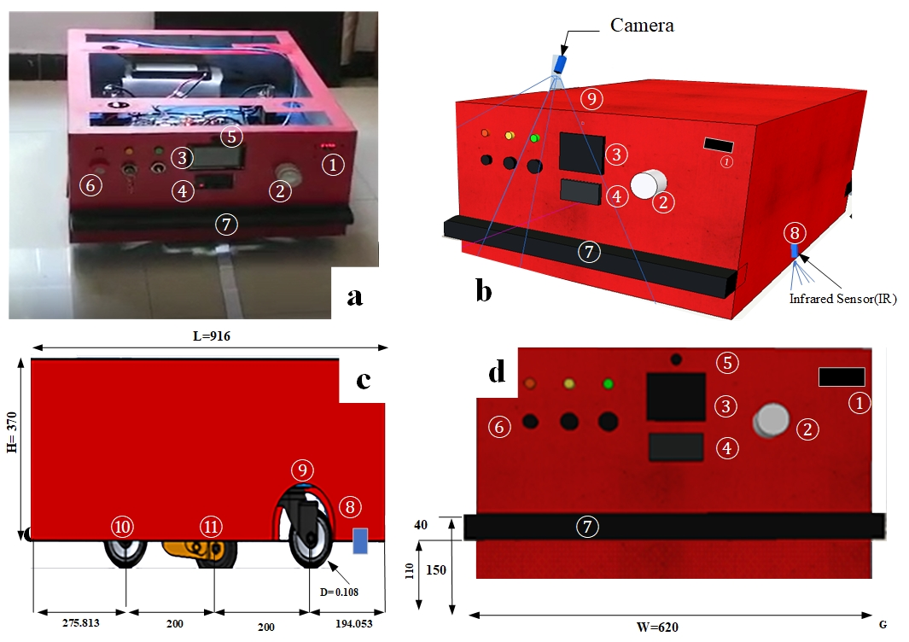
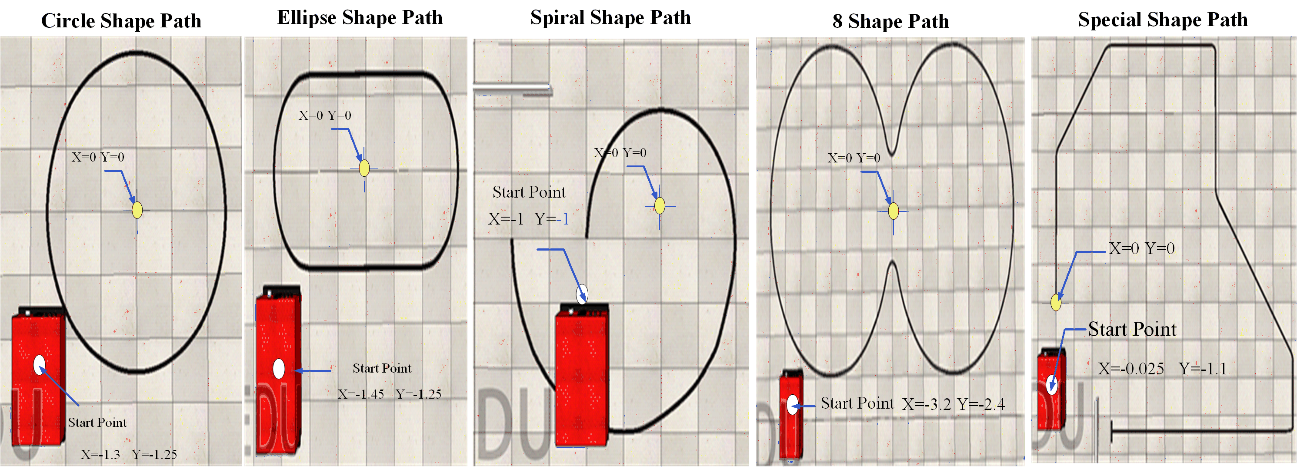

INTRODUCTION
Click here to insert your Introduction text. Type it in or copy and paste from your Word document or other source. Click once on the dashed border to highlight then drag the bottom edge up to fit. Or change the font size to fill the box.
To have the box automatically re-size to your text: Double-click near the edge to open the Format tool, and select ‘Text Box’, then check “Resize AutoShape to Fit Text”.
To change the background color of this text box: Double-click near the edge to open the Format tool, select ‘Colors and Lines’, and change the fill color to whatever you like.
The various elements and text boxes included in this template are examples of what we commonly see on posters of this kind. They are simply placeholders and you should feel free to add, delete, re-arrange, re-name, or re-size as best suits your needs.
ABSTRACT
Click here to insert your Abstract text. Type it in or copy and paste from your Word document or other source.
This text box will automatically re-size to your text.
To change the background color of this text box: Double-click near the edge to open the Format tool, select ‘Colors and Lines’, and change the fill color to whatever you like.
To change the font style of this text box: Click on the border once to highlight the entire text box, then select a different font or font size that suits you. This text is in Arial 22pt and is easily readable up to 3 feet away in a 24x48 poster, and up to 6 feet away in a 48x96 poster (file printed at 200%).
RESULTS
Click here to insert your Introduction text. Type it in or copy and paste from your Word document or other source. Click once on the dashed border to highlight then drag the bottom edge up to fit. Or change the font size to fill the box.
To have the box automatically re-size to your text: Double-click near the edge to open the Format tool, and select ‘Text Box’, then check “Resize AutoShape to Fit Text”.
To change the background color of this text box: Double-click near the edge to open the Format tool, select ‘Colors and Lines’, and change the fill color to whatever you like.
The various elements and text boxes included in this template are examples of what we commonly see on posters of this kind. They are simply placeholders and you should feel free to add, delete, re-arrange, re-name, or re-size as best suits your needs.
DISCUSSION
Click here to insert your Introduction text. Type it in or copy and paste from your Word document or other source. Click once on the dashed border to highlight then drag the bottom edge up to fit. Or change the font size to fill the box.
To have the box automatically re-size to your text: Double-click near the edge to open the Format tool, and select ‘Text Box’, then check “Resize AutoShape to Fit Text”.
To change the background color of this text box: Double-click near the edge to open the Format tool, select ‘Colors and Lines’, and change the fill color to whatever you like.
The various elements and text boxes included in this template are examples of what we commonly see on posters of this kind. They are simply placeholders and you should feel free to add, delete, re-arrange, re-name, or re-size as best suits your needs.
Published result
Video
Ferrández-Pastor, Francisco, et al. "Developing ubiquitous sensor network platform using internet of things: Application in precision agriculture." Sensors 16.7 (2016): 1141
Gondchawar, Nikesh, and R. S. Kawitkar. "IoT based smart agriculture." International Journal of advanced research in Computer and Communication Engineering 5.6 (2016): 838-842
Krishna, K. L., Silver, O., Malende, W. F., & Anuradha, K. (2017). Internet of Things application for implementation of smart agriculture system. 2017 International Conference on I-SMAC (IoT in Social, Mobile, Analytics and Cloud) (I-SMAC). doi:10.1109/i-smac.2017.8058236
P. J. Sarkar and S. Chanagala, “IoT based Digital Agriculture Monitoring System & Their Impact on Optimal Utilization of Resources,” J. Res. Vol., vol. 4, no. 01, pp. 1–4, 2018
QR
QR

Slide 5

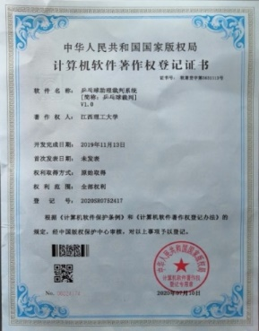
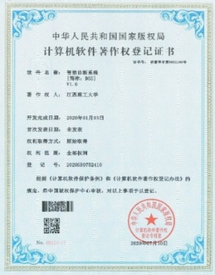
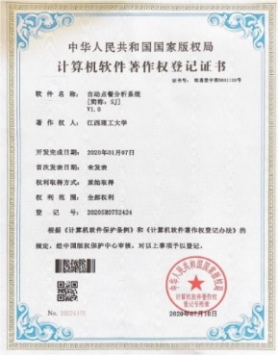
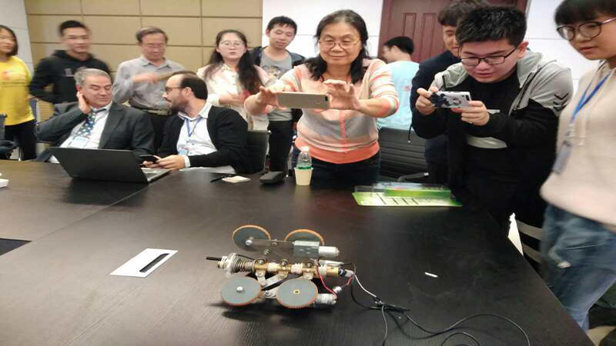
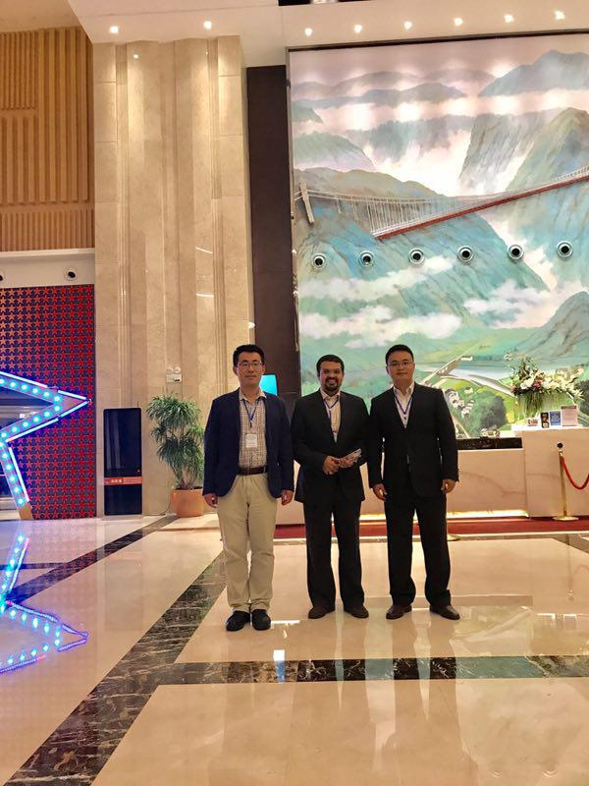
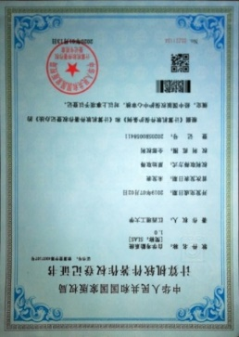
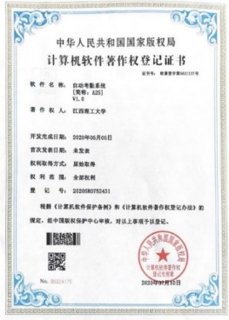
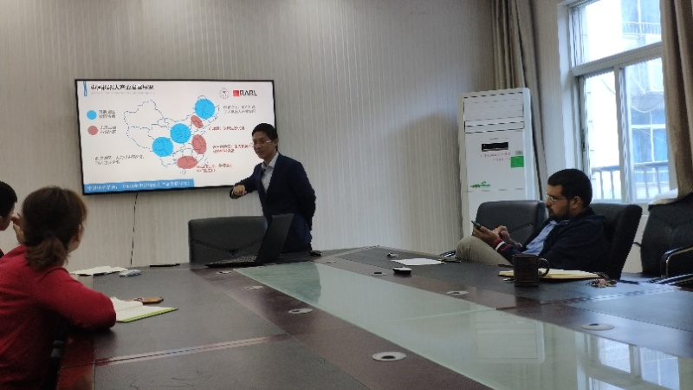
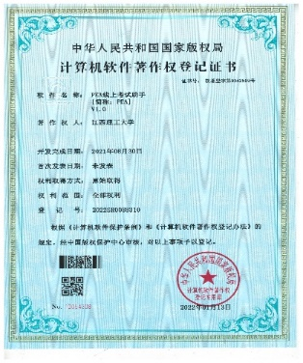
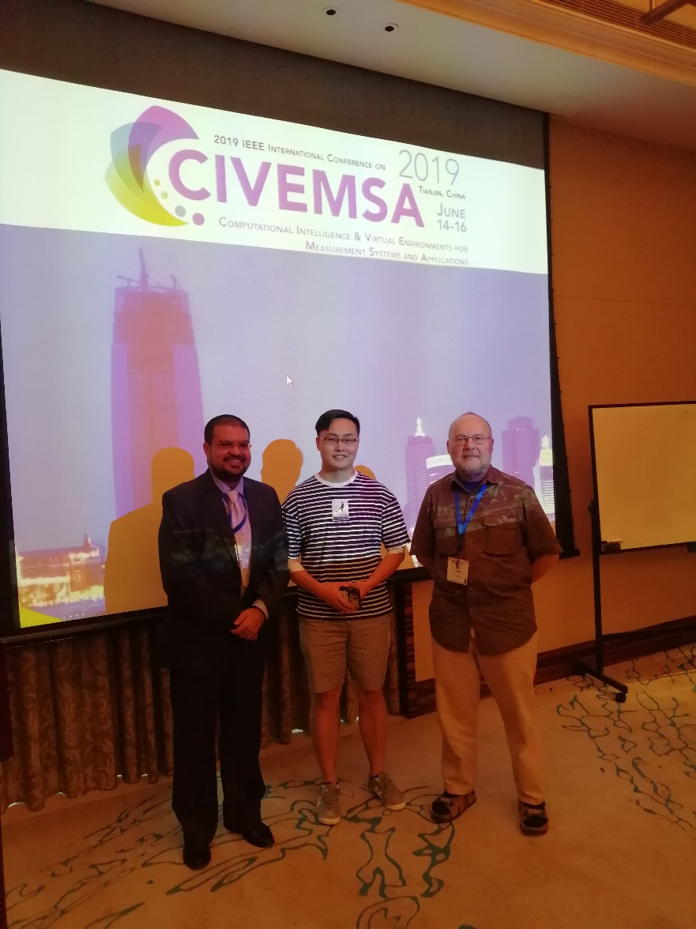
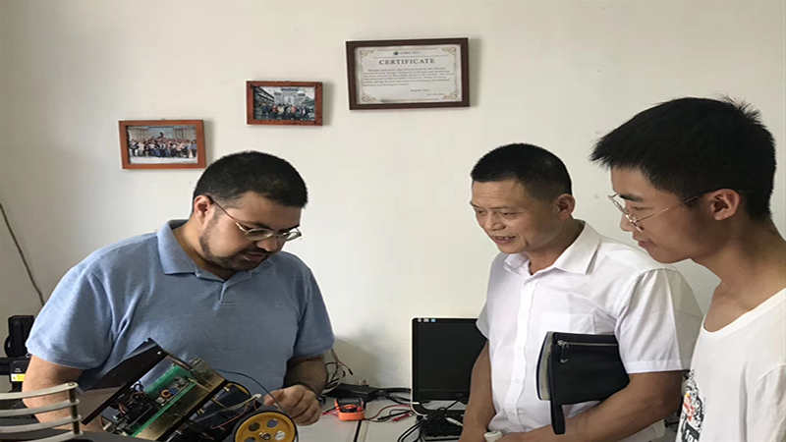
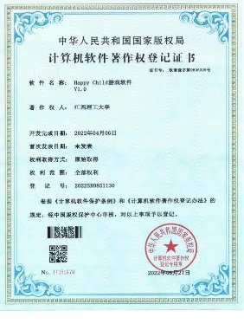
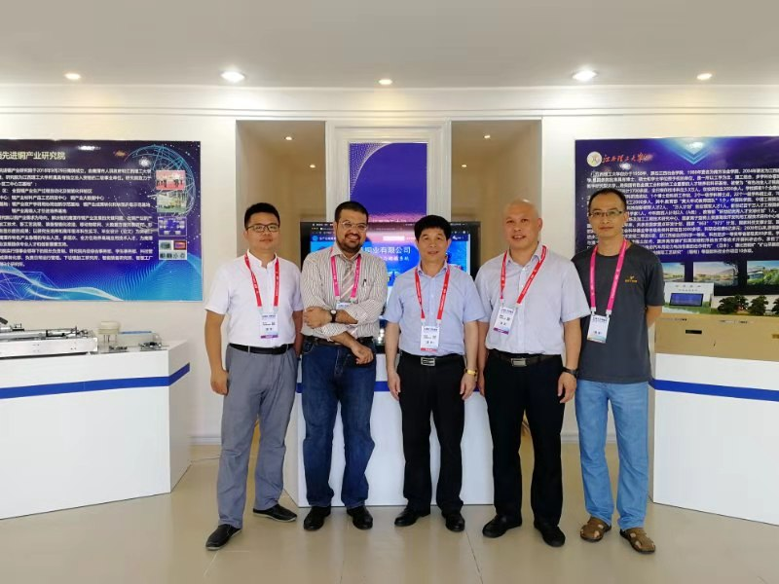
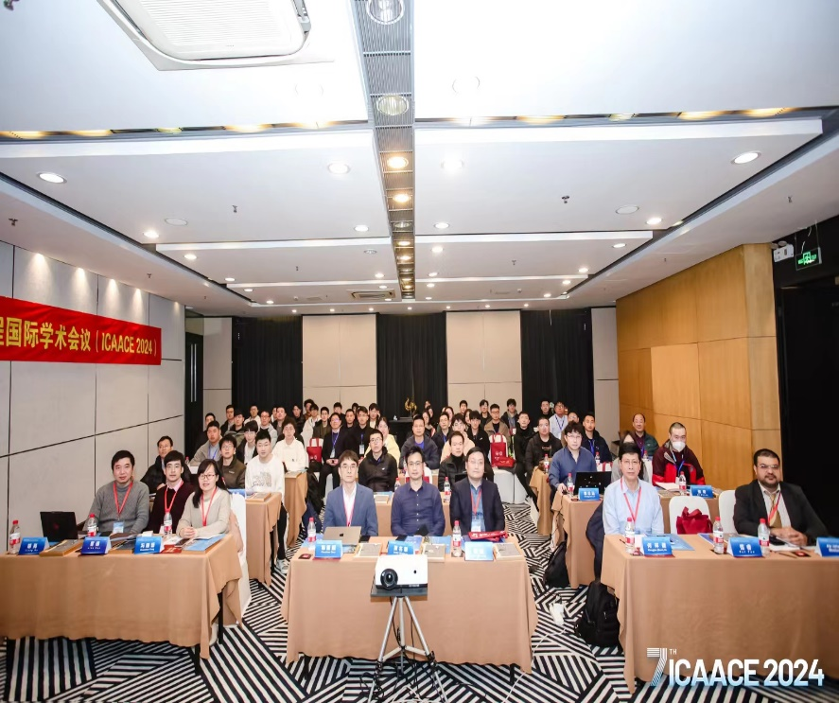
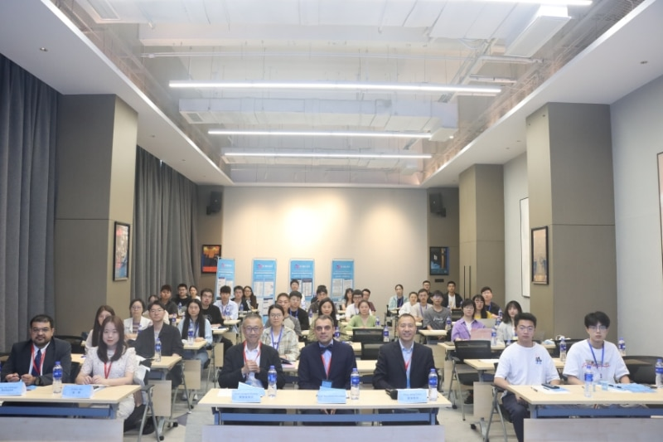

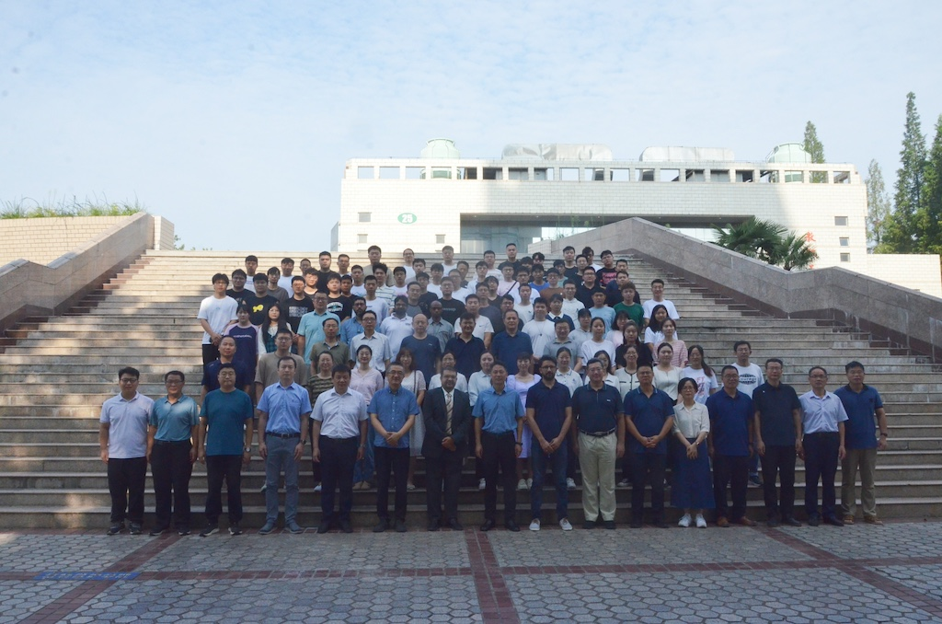
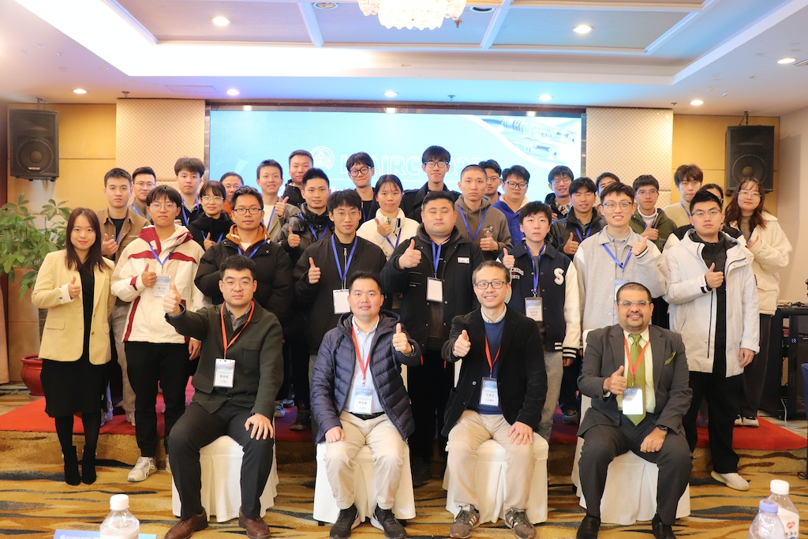
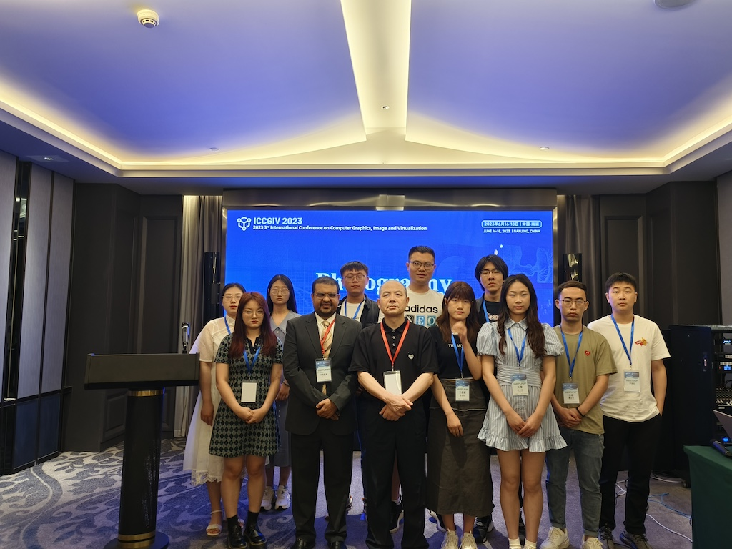
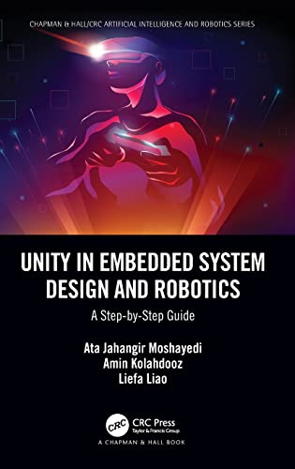
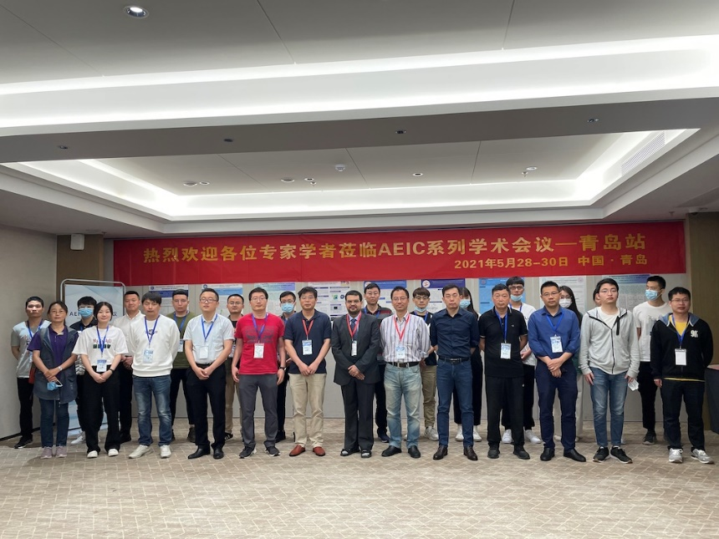
Robotics And Research Automaton Lab (RARL]
RESULTS
Welcome To RARL
This centre is started to develop design and various robot specially in the filed of service robot and active in automation project. The main target over than research in this filed is consulting and help industry for automation solution.
5
2019
DISCUSSION
Click here to insert your Introduction text. Type it in or copy and paste from your Word document or other source. Click once on the dashed border to highlight then drag the bottom edge up to fit. Or change the font size to fill the box.
To have the box automatically re-size to your text: Double-click near the edge to open the Format tool, and select ‘Text Box’, then check “Resize AutoShape to Fit Text”.
To change the background color of this text box: Double-click near the edge to open the Format tool, select ‘Colors and Lines’, and change the fill color to whatever you like.
The various elements and text boxes included in this template are examples of what we commonly see on posters of this kind. They are simply placeholders and you should feel free to add, delete, re-arrange, re-name, or re-size as best suits your needs.
2022

